Slide 1
Capstone Project
Global Terrorism Analysis
TEAM NAME: BETA_UP_YOUR_MIND
TEAM MEMBERS
Satyajit Mohanty
Prince Kumar Jha
Atharva Ghorpade
A Veekshita Sai Choudhary

Slide 2

Global Terrorism Analysis
Terrorism is defined as political violence in an asymmetrical conflict that is designed to induce terror and psychic fear (sometimes indiscriminate) through the violent victimization and destruction of noncombatant target.
The Global Terrorism Database(GTD) is a database including information on terrorist events around the world from 1970 through 2017. Unlike many other event databases, the GTD includes systematic data on domestic as well as international terrorist incidents that have occurred during this time period and now includes more than 181,000 cases.
In the following slides, we will understand on how the world has been affected by these terror attacks.

Slide 3
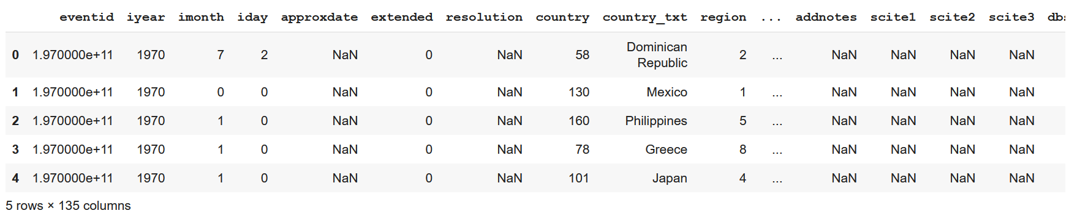
Raw Data
Above picture depicts the raw data of Global Terror Attacks. The data has not been cleaned and contains unnecessary values.

Slide 4
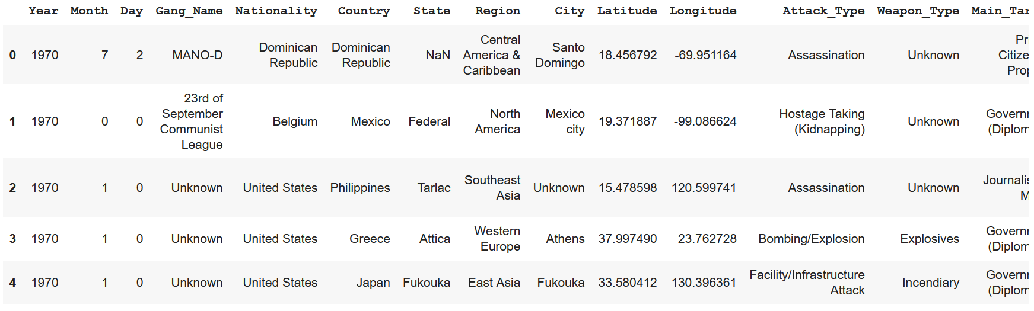
Cleaned Data
Above picture depicts the cleaned data of Global Terror Attacks. The data has been cleaned and the column names have been modified.

Slide 5

OVERVIEW
Analysis based on attacks
Top 10 Terrorist organization with most no. of attacks.
Top terrorist organization and their favourite attack types.
Type of attack mostly used by the terrorist organization.
Top 10 most attacked targets.
Yearly growth of terrorist attacks.

Slide 6
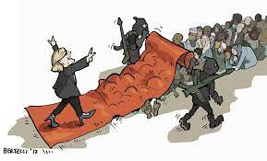
Analysis based on Killings
Top 10 terrorist organization with highest kills.
Location in which 50+ people were killed in the year which having the most terrorist attacks.
Death analysis in both Country and Region wise.

Slide 7

Analysis based on Country, region and State
Top 10 most attacked countries.
Most attacked region and state.

Slide 8
Data Summary
Year: Year of attack
Month: Month of attack
Day: Day on which attack happened
Country: Country in which attack happened
Gang_Name: Name of the gang that attacked
Main_Target: Type of people who have been targeted in the Attack_Type: Type of attack used by the gang.
State: state in which attacked happened
Regions: the regions where attack has happened.
killed: Number of people killed in the attack.

Slide 9
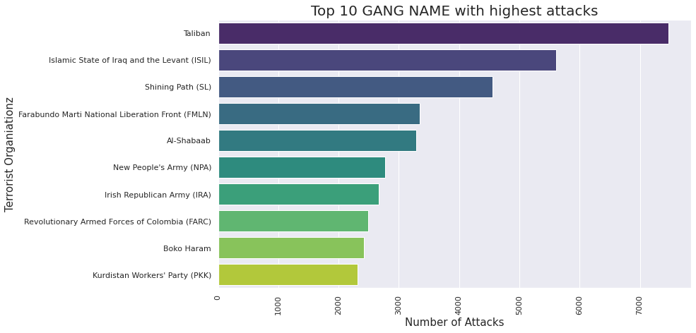
Analysis based on attacks

Slide 10
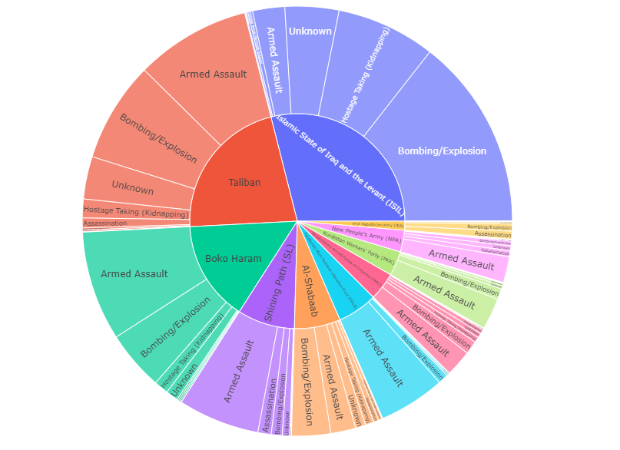
Top Terrorist Organizations and Attack Types

Slide 11
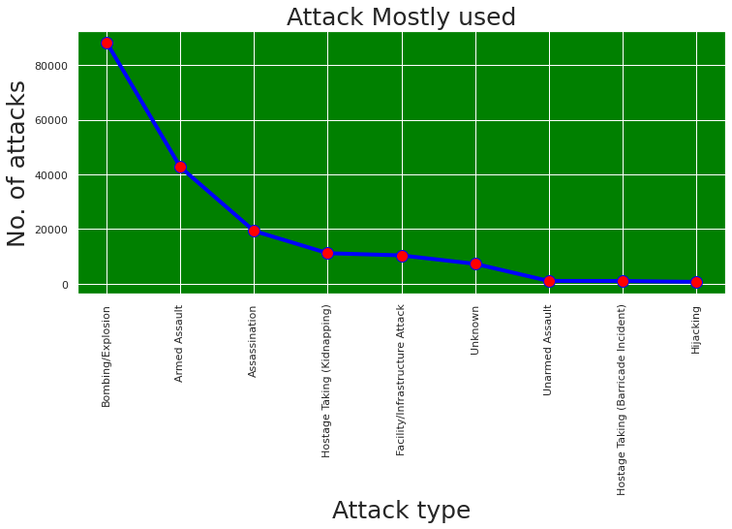

Slide 12
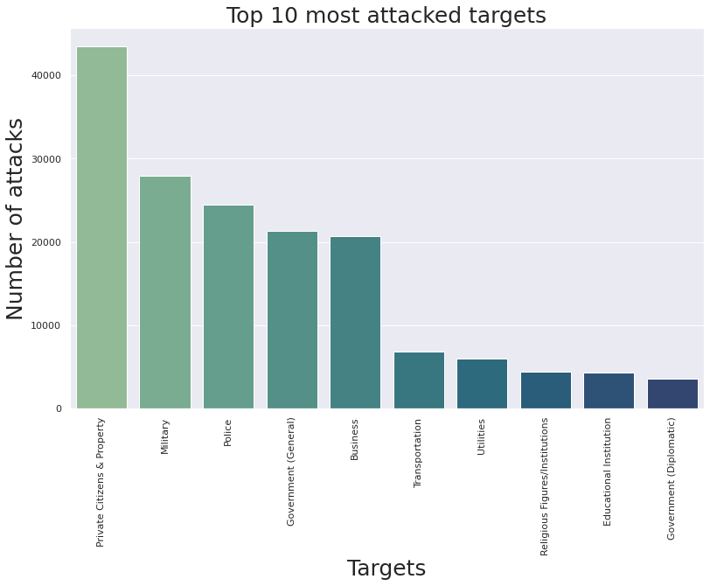

Slide 13
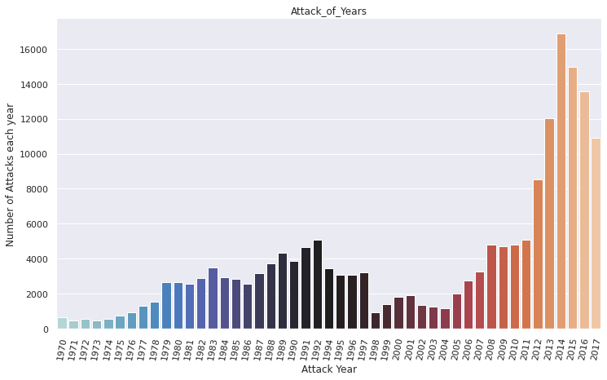

Slide 14
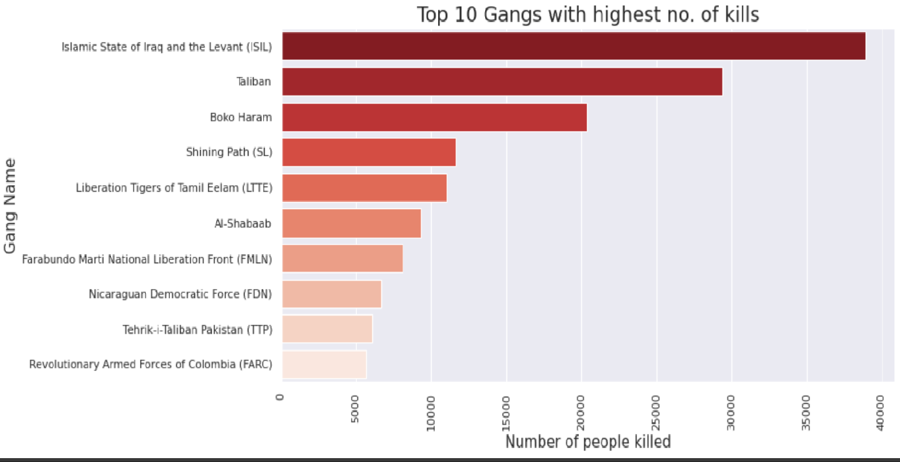
Analysis based on killings

Slide 15
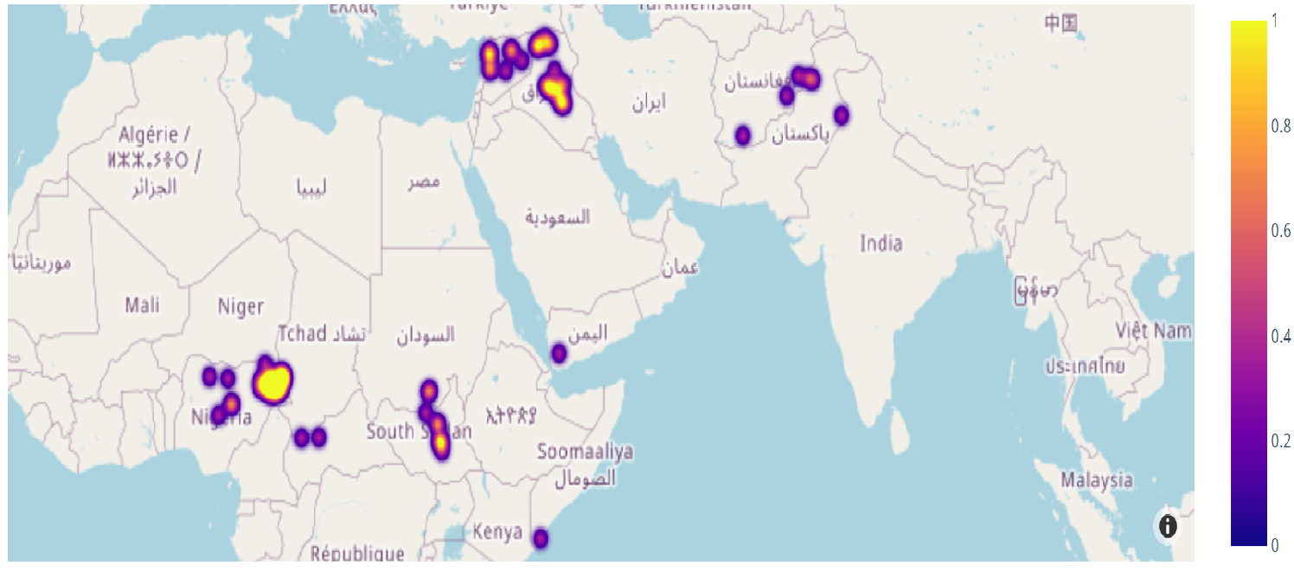
Location where Killings were More Than 50 People (2014)

Slide 16
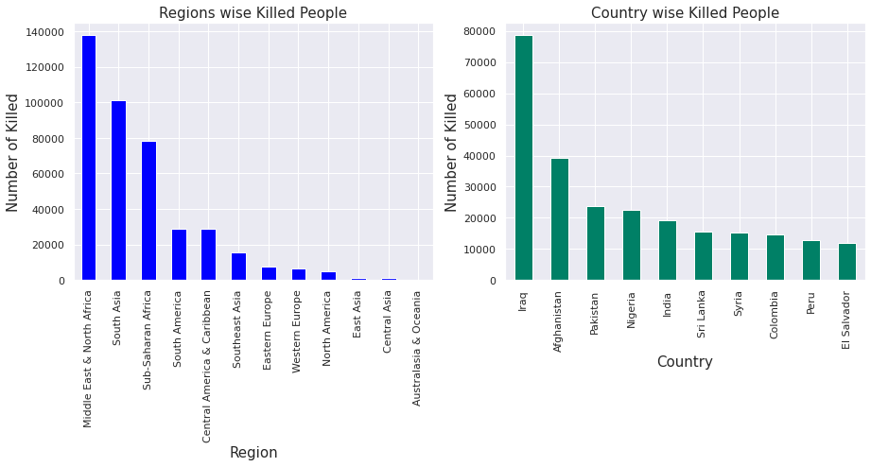

Slide 18
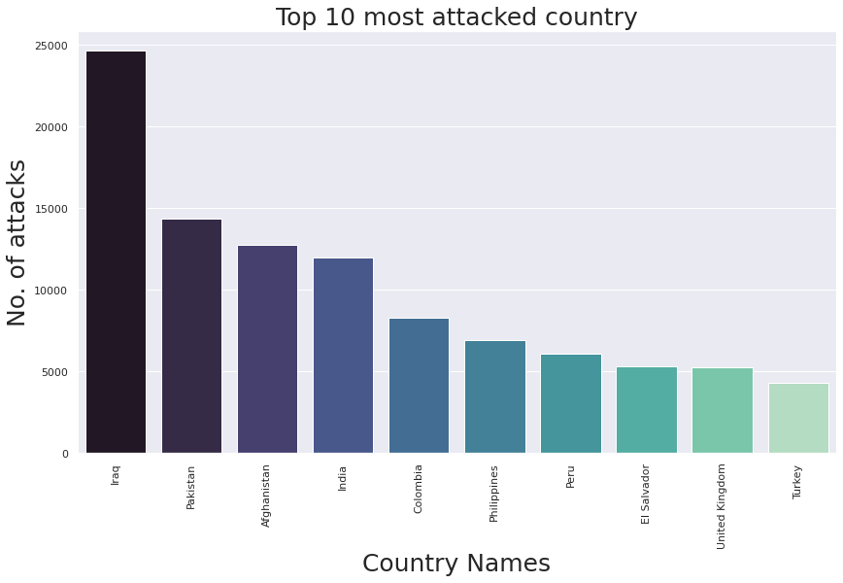
Analysis based on country,region and state

Slide 19
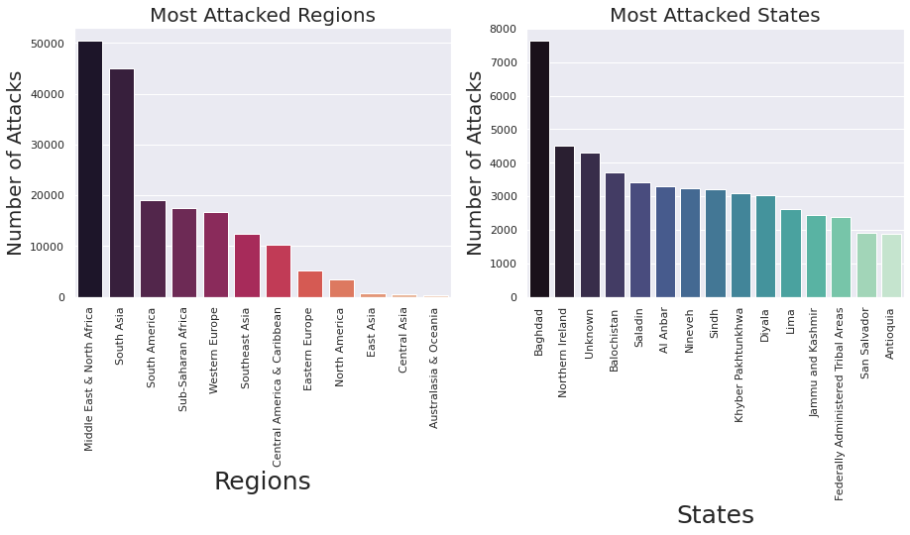

Slide 21
CONCLUSION
"Taliban" is the most powerful, dangerous and the most active gang among all of the gangs, followed by "Islamic state of Iraq and the levant(ISIL)" and "shining path(SL)".
"Islamic State of Iraq and the Levant (ISIL)" killed the highest number of people which is approximately 40k followed by "Taliban" and "Boko Haram" with an approximation of 30k & 20k respectively.
50% of the attacks have occurred because of Bombing/Explosion and 10-20% occurred because of Armed Assault & Remaining other are in between 0-6%.
After 2011 we can observe that there is a large growth recorded in terrorist attacks followed by 2014 which appears to witness a sudden growth in the terrorist attacks.
“Iraq" is the country that has the highest number of people killed due to terrorist attacks, approximately 80k followed by "Afghanistan" & "Pakistan“.

Slide 22
Among all the regions "Middle East & North Africa" has the most number of killed people approximately 1.4 Lakhs followed by "South-Asia" & "Sub-Saharan Africa".
The most targeted attacks are on "Private Citizens & Property" which is approximately 25% and 10-20% is the target on "Military", "Police", "Government", "Business".
Most number of attacks have happened in the "Baghdad" followed by “Northern Ireland“ and other many other states.

Slide 23
THANK YOU

